Slide 1

SONG RECOMMENDATION SYSTEM
By :-
Aniket Mali
Jayapriya TR
Mayur Mapari
Niraj Palve
Pinto A
Saranrraj A
MENTOR :- NEHA MA’AM DATE:- 07/07/2022

Slide 2
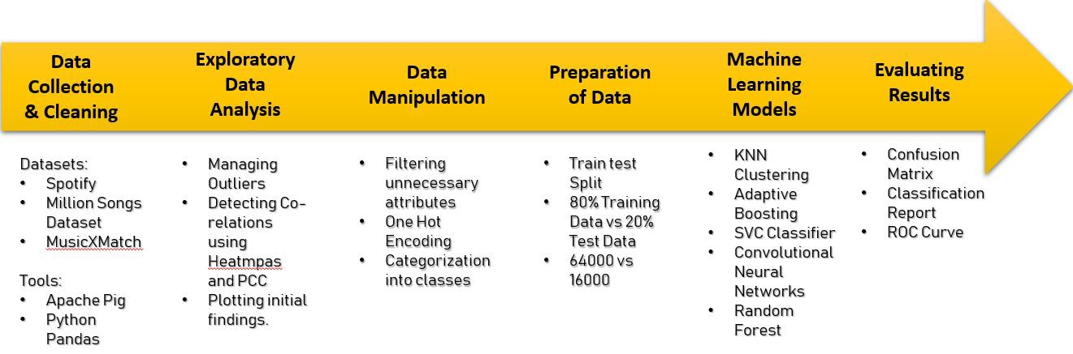
PROJECT FLOW

Slide 3


BUSINESS OBJECTIVE
The aim of this project is to build a feature of recommendation system to support a music app.
As the first phase we need to develop the proof of concept to make the client understand how effective the feature would be.

Slide 4

DATA COLLECTION
Data:-Spotify 1.2M+ Songs
Source:-Kaggle
Data Specifications:-
Shape (6911,18)
No.of Features are 18

Slide 5
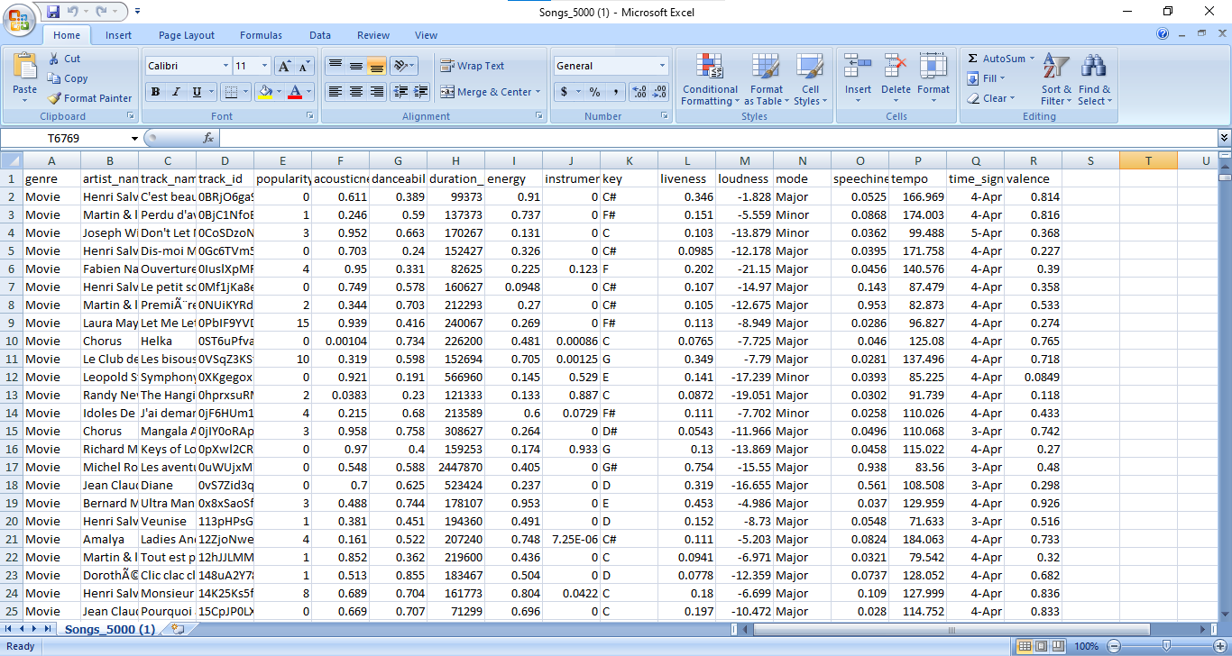

Slide 6
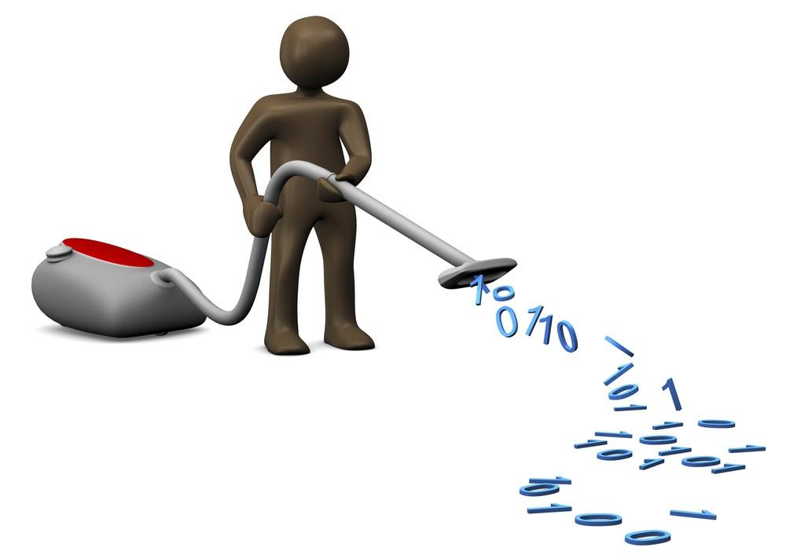
DATA CLEANING
The main objective of data cleaning is to eliminate errors and redundancy and to increase reliability for our system
So the first step of Data cleaning is done with the effective manner in order to provide good feedback from our system

Slide 7

Exploratory Data Analysis
The main objective of EDA is to maximize our insight into a data set and into the underlying structure of a data set
So the next step EDA is done in our dataset to detect outliers from the data set

Slide 8
Data Visualization
It is the practice of translating information into a visual context, such as a map or graph, to make data easier for the human brain to understand and pull insights from.
The main goal of data visualization is to make it easier to identify patterns, trends and outliers in large data sets.

Slide 9
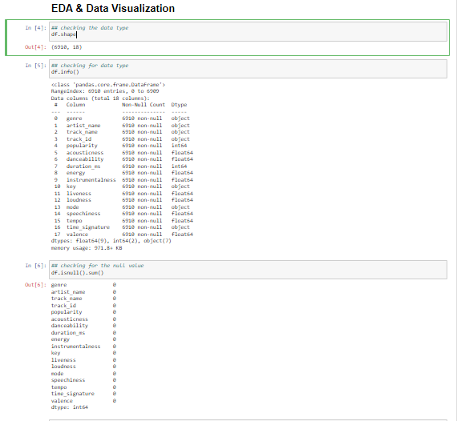
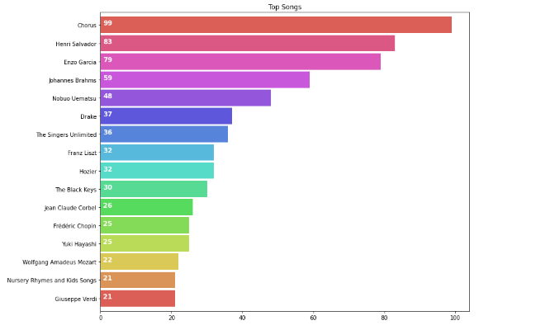
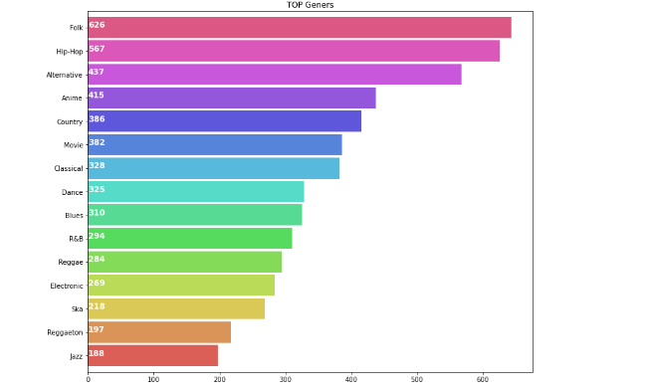

Slide 10
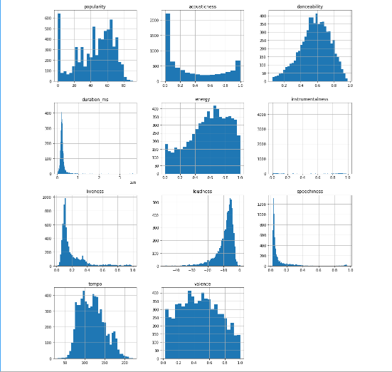

Slide 11
Conclusion of EDA
Energy and valence are more related it means the energized songs are more positive
Danacability and valance also shows same relation.
Energized song are also more loud and dancing songs have more time duration.

Slide 12

Data Manipulation
It is the method of organizing data to make it easier to read or more designed or structured and also to create more value from our data.
Alters Relationship between the data Items.

Slide 13
Data Preparation
Good training data is the backbone of every system Understanding the importance of training dataset
It ensures the right quality and quantity of training data for training our mode
So the Train and Test data has been splitted as 80% and 20% i.e.,5911 vs 1382

Slide 14
Data Modeling
We used contentent based recommendation system for that we used following models
Cosine similarity matrix
KNN With Kd tree
KNN with Ball tree
K-Means

Slide 15
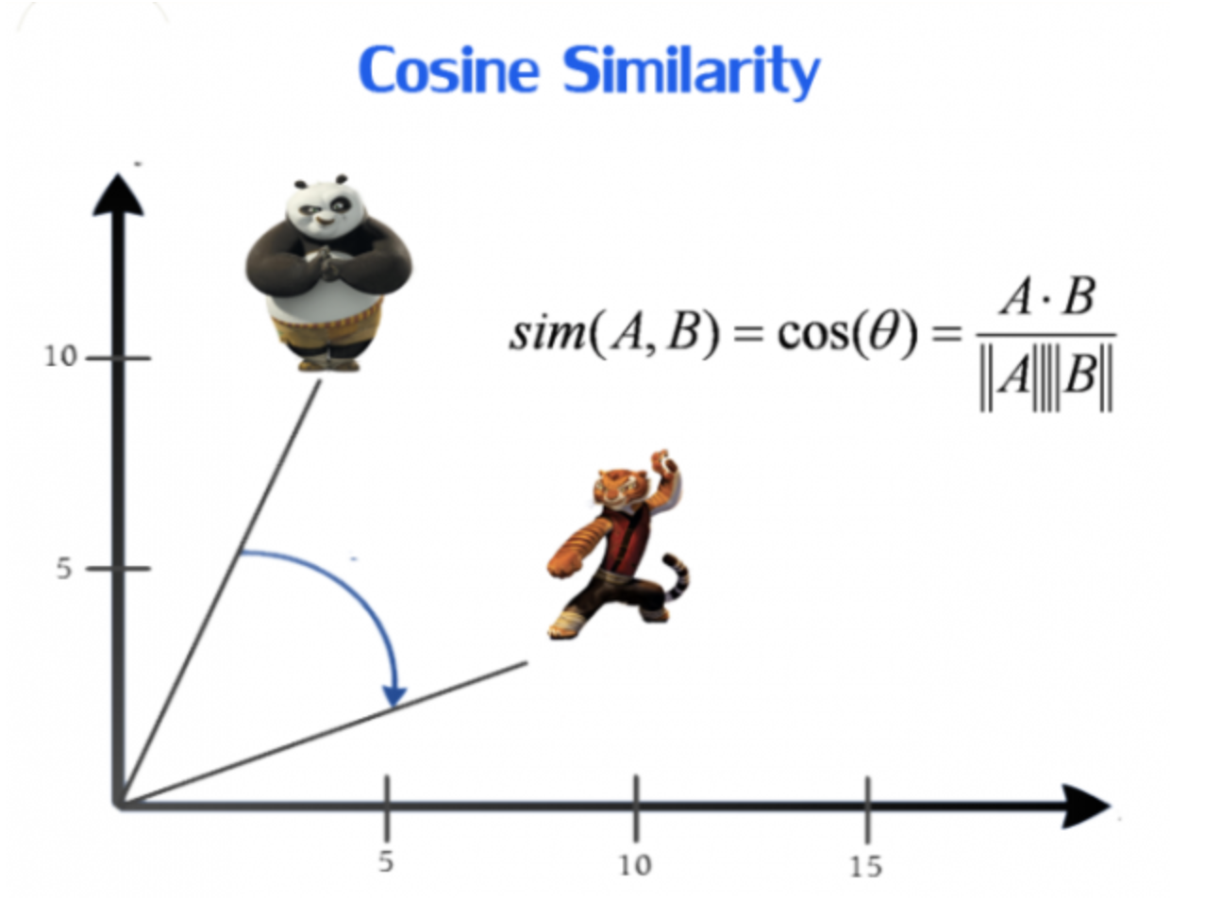
Cosine similarity Model
Cosine similarity is based on similarity score between each element in the vector.
In our case first we convert our catagorical data into numbers using bag of words . This create vectors of no.of records* words in BOW(6807*3772)
After that we calculating the similarity score using cosine similarity
It calculated the similarity score with each item In record i.e(6807*6807)

Slide 16
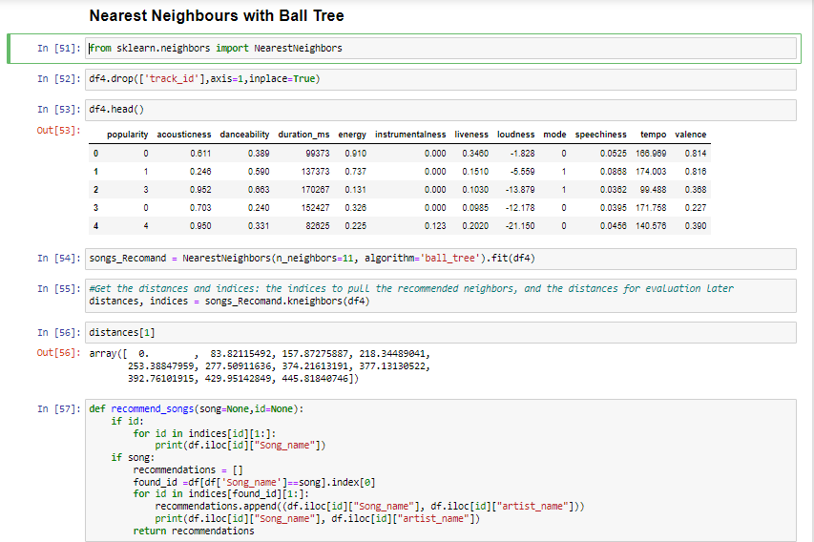
Nearest neighbour found Using Ball tree method

Slide 17
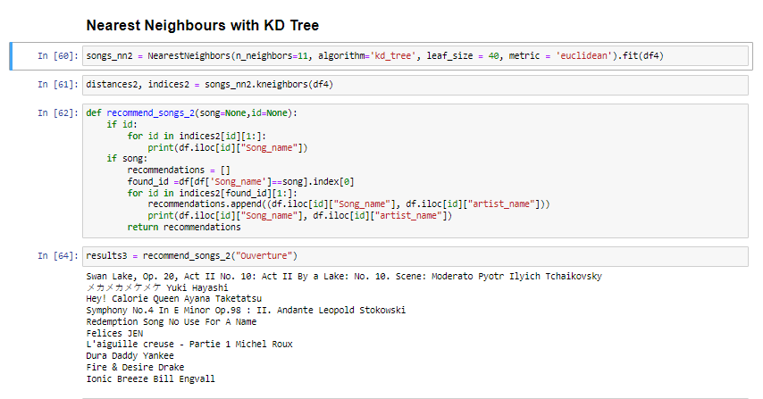
Using KD tree method

Slide 18
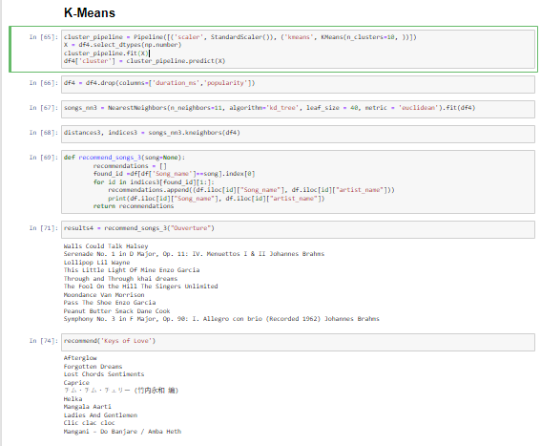
Using K-means method

Slide 19
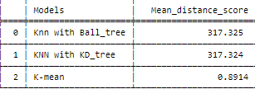
Conclusion of Model Evaluation:
The similarity model using genres is found to be accurate than other since it depends on genre and artist_name .
So either cosine similarity or k-mean model is used for deployment.

Slide 20
Model Deployment
●With the help of similarity score we choose our cosine similarity model for the deployment.
●We deployed our model with the help of streamlit.
●Streamlit is an open-source app framework for creating and deploying data science applications.
●It is easy to operate.
●We deploy our model in anaconda prompt
●We use following function in anaconda prompt
Streamlit run app.py

Slide 21
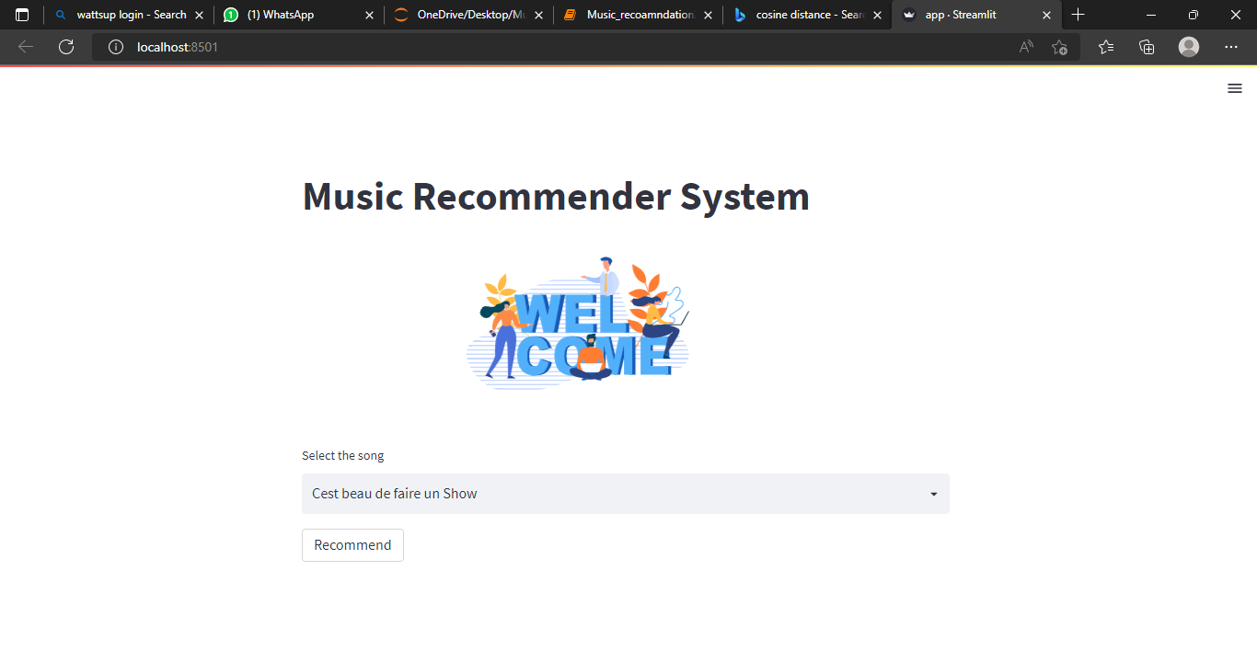

Slide 22
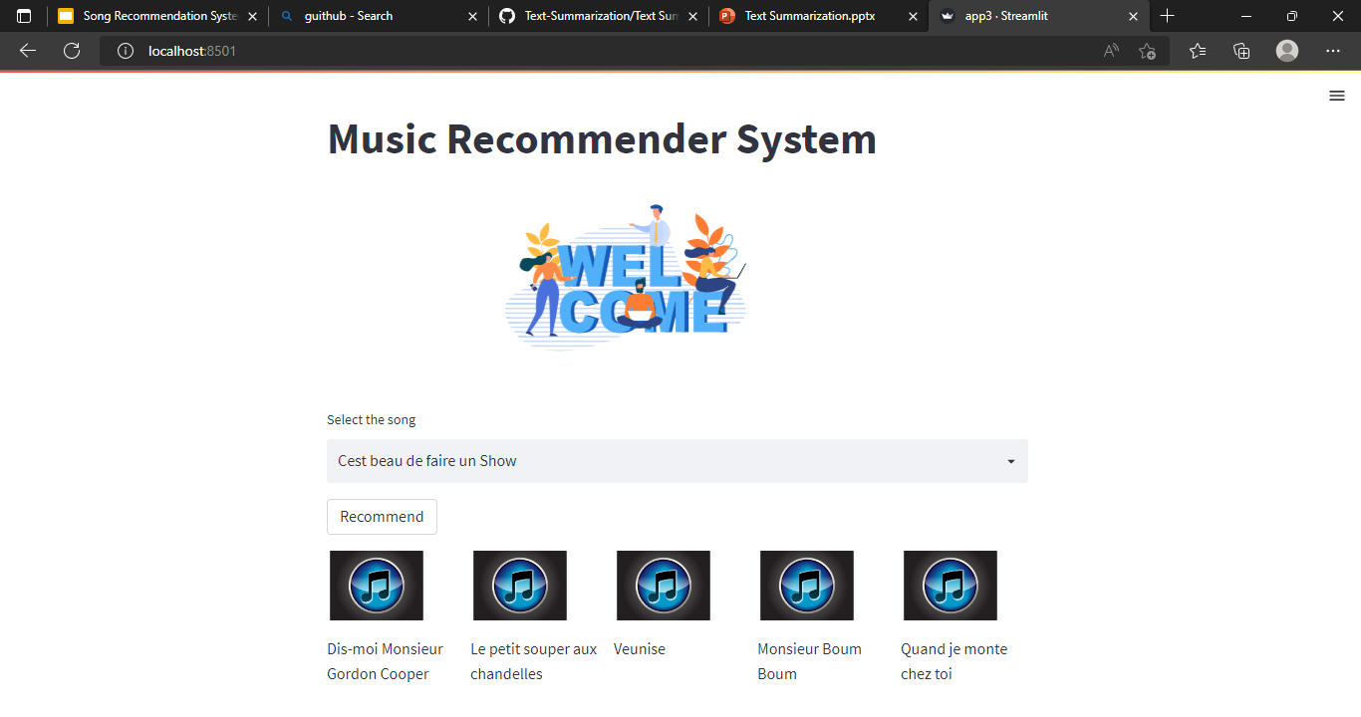

Slide 23
CHALLENGE’S FACED
Faced difficulties while searching the data set for the Music.
Faced the space difficulties while Building the cosine similarity model as the data is large.
Faced Difficulties while evaluating the models.
Faced difficulties during pickle and dump the large file in the streamlit.
Faced difficulties During deployments.
Faced the difficulties to make a app on heroku.

Slide 24


